Slide 1
HL ONLY
TOPIC A4:
MACHINE LEARNING
LESSON A4-6
DECISION TREES

Slide 2
AGENDA
Warm up
What a decision tree is
Reading a tree
Building a tree
Choosing the first question
When the tree stops
Trees against k-NN
Medical diagnosis
Lab
WHAT U NEED 4 LESSON
Guided Notes
ur hedz

Slide 3
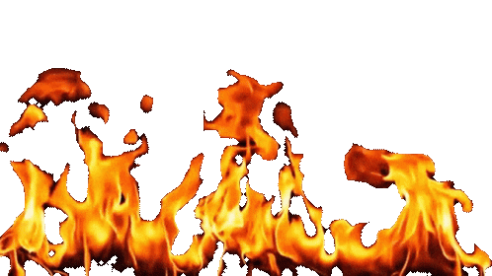
WARM UP QUESTION
(a) A regression line is y = 0.4x + 15. State what the 0.4 means [1]
(b) Calculate the predicted y when x = 20 [1]
(c) State what k-NN does with a new data point [1]
→ Notes Q1 (a), (b), (c)

Slide 4
WARM UP ANSWER
(a) Every one-unit rise in x raises y by 0.4
(b) 0.4 × 20 + 15 = 23
(c) It measures the distance to every stored example, takes the k closest, and the most common category is what is inferred

Slide 5
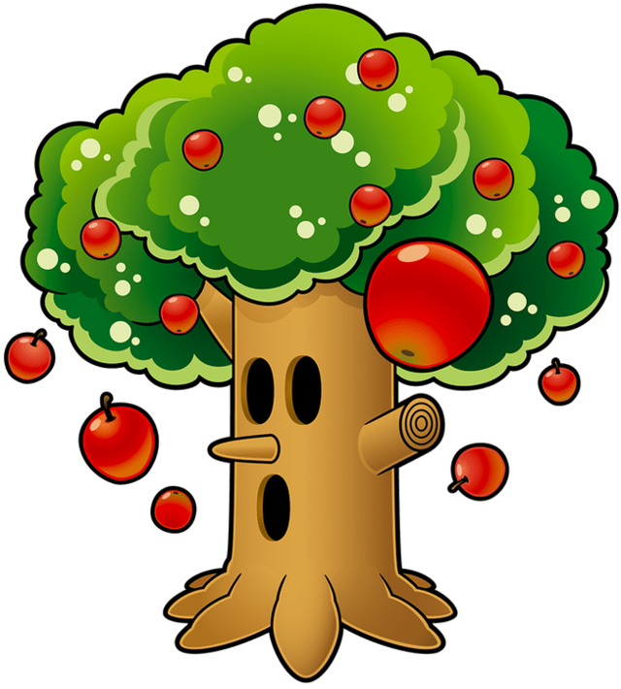
WHAT A DECISION TREE IS
A decision tree is a chain of yes-or-no questions ending in an answer
  These are very similar to flowcharts, or the tree abstract data structure
    Programmers aren’t particularly creative
The root node is the first question, at the top
Each branch is one answer to a question, and leads either to another question or to the end
A leaf node is where the categories are, there is no question
The tree becomes the model

Slide 6
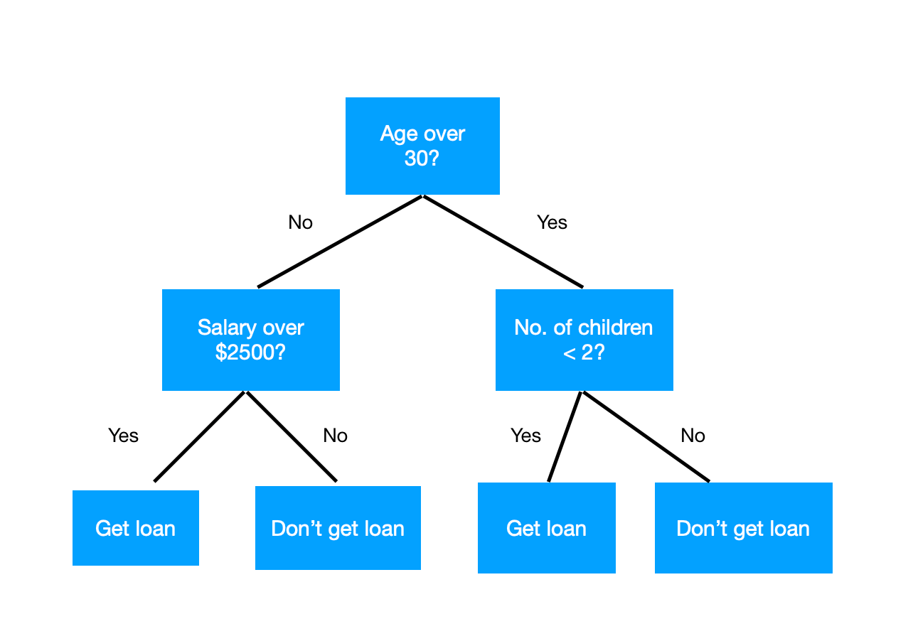
WHAT A DECISION TREE IS
Like k-NN, a tree does classification, where the answer is a category, not a number
Unlike k-NN, we discard the training data when the tree model is complete
Inference happens by beginning at the root, and getting to a leaf, going down one question at a time
Three questions deep is three comparisons, regardless of how much was in the training dataset
→ Notes Q2 (a), (b) and (c)

Slide 7
READING A TREE
Here is a tree in table format built from eight patients, either having the flu or a cold
To classify somebody, start at the top and follow the answers down
If you’re a bio (or ESS!) nerd, this is a LOT like a dichotomous key
Question / leaf | If no | If yes
Body aches? | Cold | go to the next question
High fever? | Cold | Flu

Slide 8
READING A TREE
Assume that a patient arrives with no body aches
  This answers our first question, and leads us to the leaf node of Cold
A second patient has body aches and a high fever
  Follow the body aches to the high fever question, leading you to flu
A third has body aches but no fever. Follow the first question to the high fever question, which evaluates to cold
→ Notes Q3 (a) and (b)
Question / leaf | If no | If yes
Body aches? | Cold | go to the next question
High fever? | Cold | Flu

Slide 9

BUILDING A TREE
That tree was, of course, not written by a doctor, but made from training data
The algorithm is greedy: it picks the top question it can ask right now, and does the same for each of the two sides of the tree that makes
  The top question is the one that separates the categories most cleanly
A group with only one category left in it is pure, and becomes a leaf immediately
The guide does not ask you to calculate the measure of purity, so we’ll just count

Slide 10
BUILDING A TREE
Here’s the training data with three flu cases and five cold cases
→ Notes Q4
Patient | Fever | Aches | Sore throat | Diagnosis
P1 | Yes | Yes | No | Flu
P2 | Yes | Yes | Yes | Flu
P3 | Yes | No | Yes | Cold
P4 | No | No | Yes | Cold
P5 | No | No | No | Cold
P6 | Yes | Yes | No | Flu
P7 | No | Yes | Yes | Cold
P8 | Yes | No | No | Cold

Slide 11
CHOOSING THE FIRST QUESTION
Three possible first questions
  Try each one and count how well that divides the data set
Fever splits them 5 and 3
  The ‘No’ side is three colds and nothing else, so that side is pure
  The Yes side is still 3 flu against 2 colds
Sore throat splits them 4 and 4, but neither side is pure — 1 against 3, and 2 against 2, which makes the information hard to use
Aches splits them 4 and 4
The No side is four colds and nothing else, and the Yes side is 3 flu against 1 cold.

Slide 12
CHOOSING THE FIRST QUESTION
For each choice
First question | If no | If yes
High fever? | 0 flu, 3 cold (pure) | 3 flu, 2 cold
Body aches? | 0 flu, 4 cold (pure) | 3 flu, 1 cold
Sore throat? | 2 flu, 2 cold | 1 flu, 3 cold

Slide 13
CHOOSING THE FIRST QUESTION
Aches is the best first choice
  Its pure side is bigger, and the data is a tad less messy
The No branch is completed already
  Those four colds become a leaf saying Cold
The Yes branch still holds P1, P2, P6 and P7, which is 3 flu against 1 cold, we still need to ask a second question
  At this point, splitting on fever comes out pure: P1, P2 and P6 all have a fever and all have flu, and P7 has neither a fever nor flu
    There is nothing impure here, so we can put categories as the result of this question
→ Notes Q4 and Q5

Slide 14

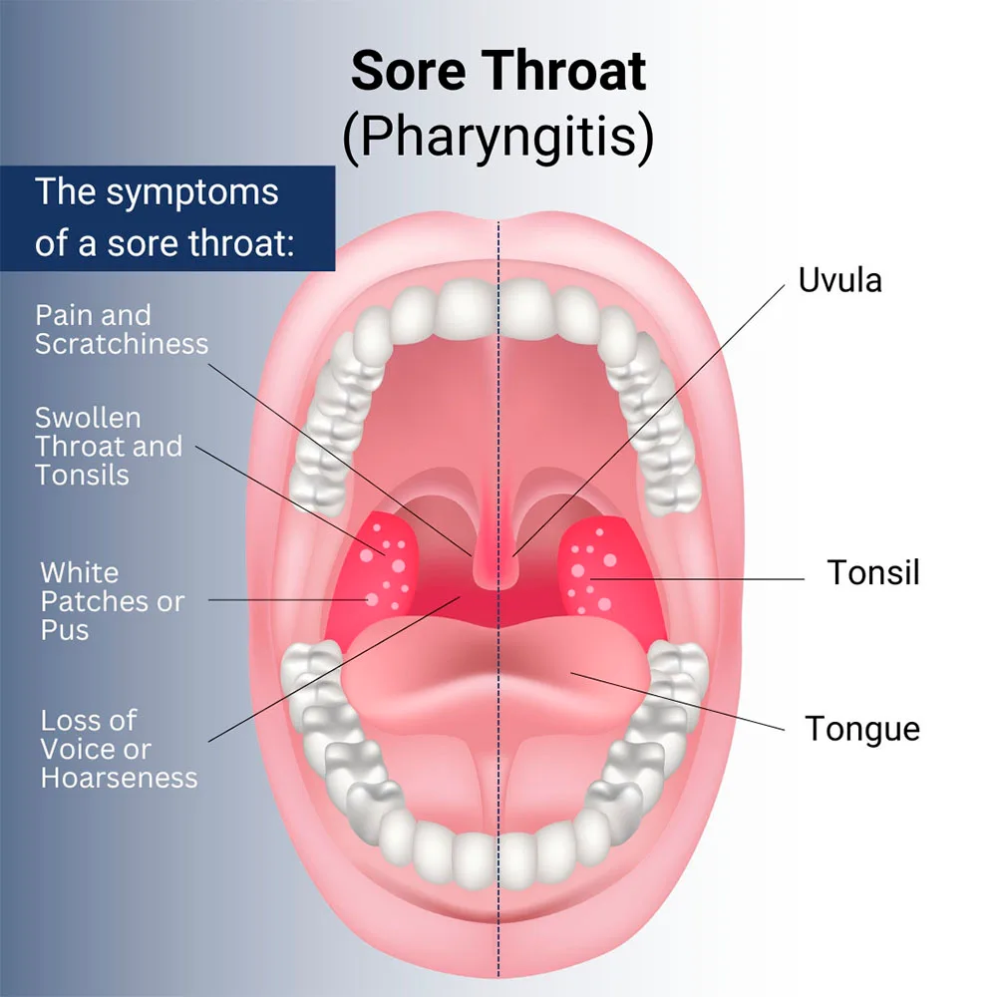
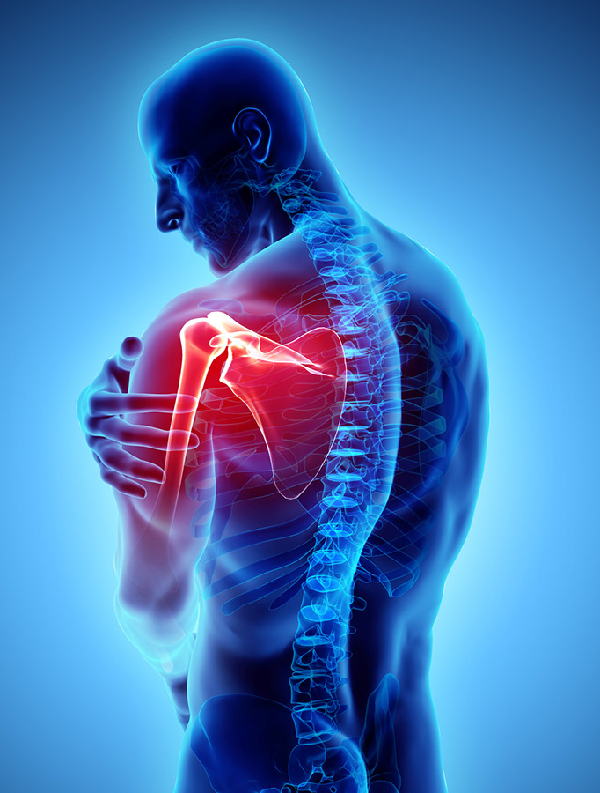

CHOOSING THE FIRST QUESTION
Note that we never asked about sore throat
  The tree automatically removed that column
That is the embedded method from lesson A4-4, – we automatically selected a feature while training! Woo!
A filter method would have scored sore throat on its own and may have ended up keeping it unnecessarily

Slide 15
WHEN THE TREE STOPS
Our tree got all eight patients right
In its default state, a tree keeps splitting until every leaf is pure, even if that means one patient per leaf
  A tree like that scores perfectly on the data it from its training set, but will be spectacularly bad on any new data
This is an example of overfitting
We have to tell the training algorithm when to stop

Slide 16
WHEN THE TREE STOPS
Maximum depth - stop training once a set number of questions have been established
Minimum samples per leaf – refuse to split on a group that is already too small
Pruning – grow the tree fully, but shorten branches that won’t be helpful on new data
  All of these are steps that we have to choose, and are not automatically done in the training process
A setting chosen by you and NOT trained is called a hyperparameter, like the k from k-NN on the last lesson
→ Notes Q6 (a) and (b)

Slide 17
TREES AGAINST K-NN
They work very differently, even though they ‘solve the same problem’
 | k-NN | Decision tree
At training | Stores every example | Builds the tree, drops the data
At prediction | Distance to all of them | A few yes or no questions
Needs normalization? | Yes, badly | No, one column at a time
Can you read it? | Not really | Yes, follow the path

Slide 18
TREES AGAINST K-NN
Pay extra close attention to the necessity of normalization
  k-NN compares columns against each other using the distance formula, so the units have to be similar
A tree only ever asks about one column at a time, so it never compares two things like shoe size and height at the same time
Now, if you do normalize - the tree builds the same shape either way, so it’s not like a bad thing
→ Notes Q7

Slide 19

MEDICAL DIAGNOSIS
The guide names medical diagnosis from a patient's symptoms as one application of decision trees, so that is the example to give if asked on an IB exam
  The reason is that the path is readable
    A tree can show a doctor the process that it followed
“No aches, so cold” makes sense logically, but saying “These three patients were nearest using k-NN” is not particularly helpful
In medicine, law and lending, being able to show the reasoning is often worth more than being slightly more accurate
→ Notes Q8

Slide 20
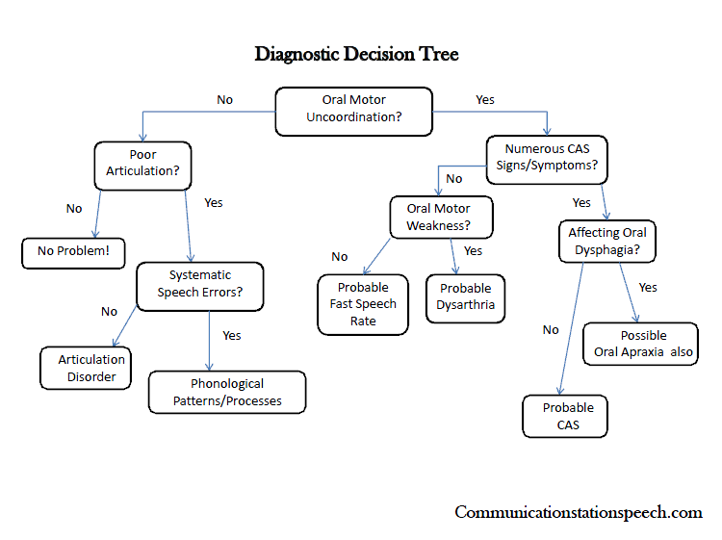
MEDICAL DIAGNOSIS

Slide 21
LAB
→ Notes Q9 and Q10
Q9 A table of six students is given. Work out which of two columns makes the better first split, showing your counts, then draw the tree. [5]
Q10 Explain one advantage of a decision tree over k-NN, and one advantage of k-NN over a decision tree. [3]

Slide 22

VOCABULARY TO REMEMBER
Decision tree
Root node
Branch
Leaf node
Classification
Pure
Greedy
Overfitting
Maximum depth
Minimum samples per leaf
Pruning
Hyperparameter
Embedded method
Explainability

